Slide 1
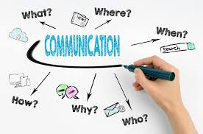
Coomunication
Created By
Bandana Das
Faculty
B.Voc(TTM)

Slide 2
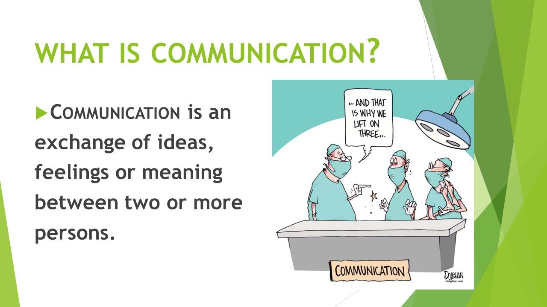
What is communication

Slide 3
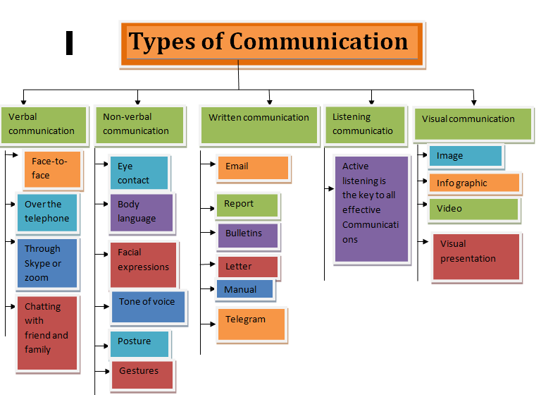
.

Slide 4

Feedback Proces

Slide 5
How to communicate effectively with your customer
Communication at work place is a crucial role in getting the work done and maintaining a healthy environment in the department and on a whole in the organization . For communicating effectively with our customer, we can follow the following guidelines:
Communicate with the customers in a polite, professional and friendly manner.
Ensure the appropriate language and tone are used to the customers.
Listen actively in a two way communication.
Be sensitive to the gender, cultural and social differences such as modes of greeting, formality etc.
Ask more questions to the customers and identify their needs.
Understand the customer expectations correctly and provide the appropriate products and services.
Understand customer dissatisfaction and address to their complaint effectively.
Maintain a positive, sensible and cooperative manner all time.
Ensure to maintain a proper body language, dress code, gestures and etiquettes towards the customers.
Avoid interrupting the customers while they talk.
Explain the terms and conditions clearly.

Slide 6


